Slide 1
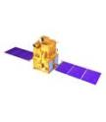
Meteorological and Oceanographic Data from Indian Satellites : Current and future
Nitant Dube
Space Applications Centre
Indian Space Research Organisation (ISRO)
Ahmedabad, India
Notes:
1

Slide 3
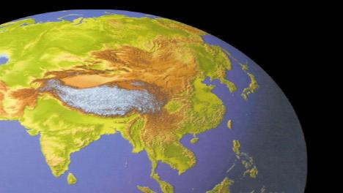
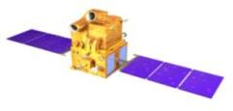
Indian Earth Observation (Themes)
Land & Water
Cartography
RISAT
C-SAR
CARTOSAT Series of Satellite
PAN and MX
Ocean & Atmosphere
RESOURCESAT
LISS 3; LISS 4; AWiFS
INSAT-3 (D,R&S) Generation
IMAGER, SOUNDER
OCEANSAT
OCM , SCAT, ROSA
SARAL
ALTIKA, ARGOS
MEGHA-TROPIQUES
MADRAS, SAPHIR, SCaRaB
INSAT- 3A
VHRR, CCD
KALPANA-1
VHRR

Slide 4
https://mosdac.gov.in
INDIAN Storehouse for Space based Weather Data
METEOROLOGICAL & OCEANOGRAPHIC DATA & INFORMATION SERVICES FROM MOSDAC
Multi Mission Satellite Data Repository | KALPANA1 (Mission Completed) INSAT3A (Mission Completed) OCEANSAT-2 MEGHA-TROPIQUES SARAL-ALTIKA INSAT3D /3DR SCATSAT-1
CAL-VAL – In situ Data | Disdrometer, MicroRain Radar, GPS Sonde, Sun Photometer, Automatic Weather Station, Agromet Station, Automatic Rain Gauge, Hyper Spectral Radiometer, Fluorometer, Radio Sonde.
Forecast | Weather, Cyclogenesis, Cyclone track & Intensity, Sea State, Heavy Rain / Cloud burst
Tools & Utilities | Visualisation and Analysis for multi-mission data
Research and Training | SMART: Satellite Meteorology and Oceanography Research and Training
http://www.mosdac.gov.in/catalog

Slide 5
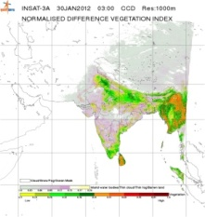
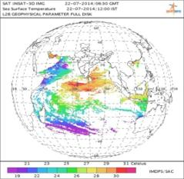
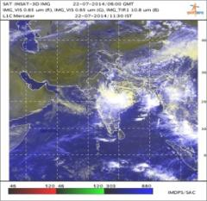
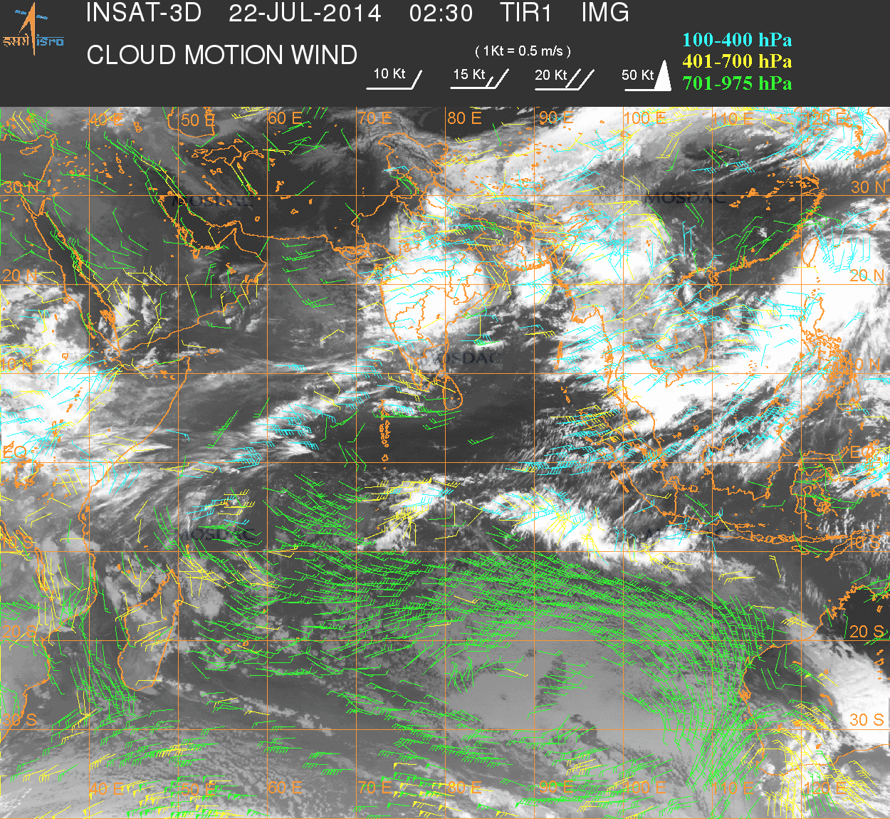
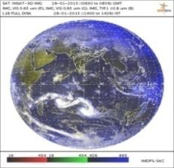
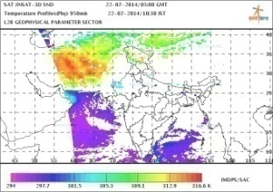
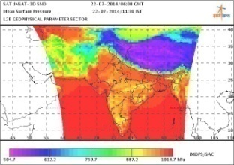
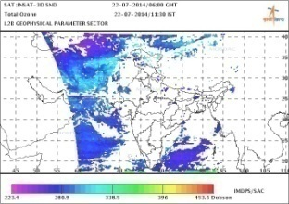
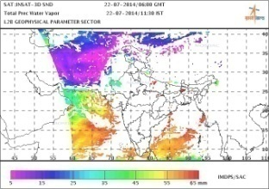
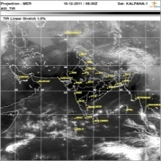
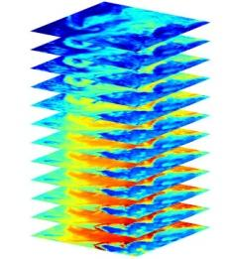
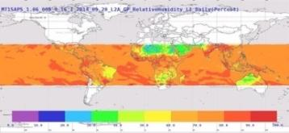
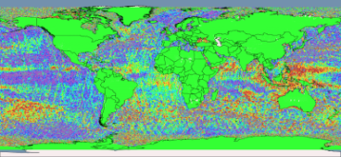
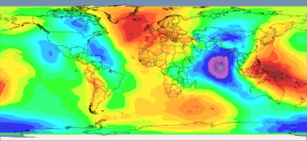
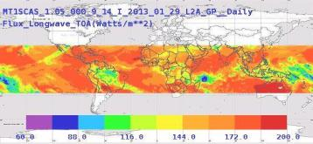
Weather Products
ND Vegetation Index
Sea Surface Temp
Sector Product
Cloud Motion Wind
INSAT – 3A / KALPANA / 3D
Full Disk Visible
Temperature
Mean Surface Pressure
Total Ozone
Total Prec.
Water Vapor
Visible band Asian sector
MEGHA TROPIQUES
Relative humidity from SAPHIR
SARAL ALTIKA
Sea surface height anomaly
INSAT 3D SOUNDER
Humidity Profile
Mean sea surface
Daily long wave flux from SCARAB

Slide 6
Past-Current-Future Missions
Past Missions Data
Name | Launch | Instruments
Kalpana-1 | 12-09-2002 | VHRR
INSAT-3A | 10-04-2003 | CCD, VHRR
Oceansat-2 | 23-09-2009 | Scatterometer (OSCAT)
Current Missions
INSAT-3D | 25-07-2013 | Imager , Sounder
INSAT-3DR | 28-08-2016 | Imager , Sounder
SARAL | 25-02-2013 | Altika
Megha-tropiques | 12-10-2011 | ROSA, SAPHIR, ScaRAB
SCATSAT-1 | 26-09-2016 | Scatterometer
Future Missions
INSAT-3DS | 2019 | Imager , Sounder
OCEANSAT-3 | 2020 | OCM, SSTM, Scatterometer
GISAT-1 | 2020 | MX-VNIR, MX-LWIR, HySI-VNIR, HySI-HWIR
OCEANSAT-3A | 2022 | OCM, SSTM, Scatterometer

Slide 7
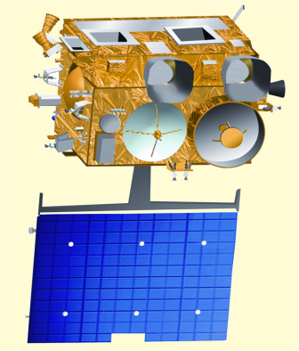
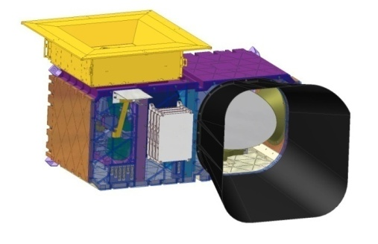
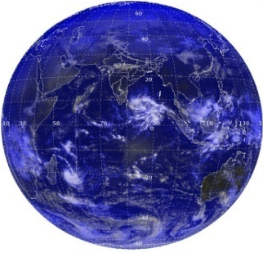
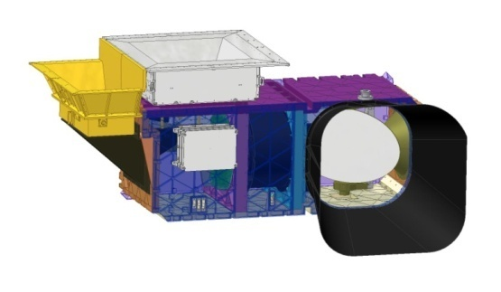
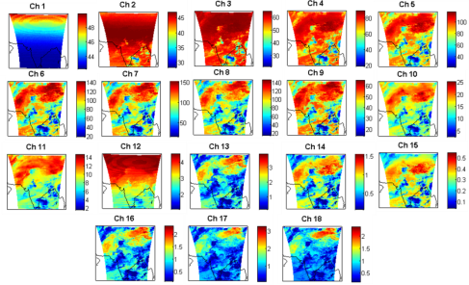
INSAT-3D/3DR
Orbit : Geostationary 82ºE/74ºE Longitude
Status : Operational
6-Channel Imager
VIS, SWIR (1) : 1 Km
TIR-1, TIR-2, MIR : 4 Km
WV : 8 Km
19-Channel Sounder
VIS (1) : 10 Km
IR(18) : 10 Km.

Slide 8
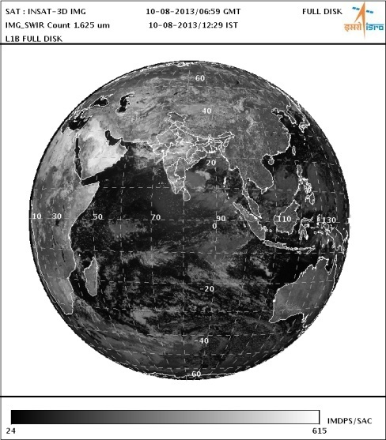
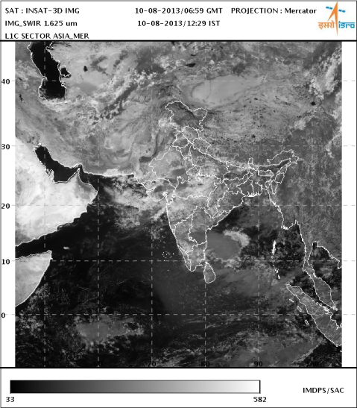
Imager Standard Products (Level-1)
S.No. | Data Product | Processing Level | Format | Product Size (MB)
Standard Products (Level-1)
1 | Standard Product Full Disk, Projected on Fixed Grid (GEOS) | L1B | HDF | 464
2 | Standard Sector Product (Map Projected) | L1C | HDF | 98

Slide 9
Imager Geo-Physical Parameters (Level-2)
Geo-Physical Parameters (Per Pixel) (L2B) |  |  |  | Product Size (MB)
1 | Outgoing long wave radiations | HDF | Per Pixel | 25
2 | Rainfall using Hydro Estimator | HDF | Per Pixel | 9.4
3 | FOG | HDF | Per Pixel | 0.102
4 | SNOW | HDF | Per Pixel | 0.216
5 | Cloud Mask | HDF | Per Pixel | 9.2
6 | Upper Troposphere Humidity | HDF | Per Pixel | 5.4
7 | Sea Surface Temperature | HDF | Per Pixel | 13
Geo-Physical Parameters (Point) (L2P)
1 | FIRE | KML | Point | 0.015
2 | SMOKE | KML | Point | 0.026
3 | Visible Winds | HDF | Point | 0.118
4 | IR Winds | HDF | Point | 0.203
5 | MIR Winds | HDF | Point | 0.259
6 | WV Winds | HDF | Point | 0.225
Geo-Physical Parameters (Gridded)(L2G)
1 | Quantitative Precipitation Index (IMSRA Method) | HDF | 0.1 deg x 0.1 deg | 0.306
2 | Quantitative Precipitation Estimation (GPI Method) | HDF | 1 deg x 1 deg | 0.024
3 | Aerosol Optical Depth | HDF | 0.1 deg x 0.1 deg | 0.606

Slide 10
Imager Geo-Physical Parameters (Level-3)
Binned Geo-Physical Parameters (Temporally Binned) |  |  |  | Product Size (MB)
1 | Outgoing long wave radiations (L3B) | HDF | Daily, Weekly, Monthly and Yearly Per Pixel | 25
2 | Rainfall using Hydro Estimator (L3B) | HDF | Daily, Weekly, Monthly and Yearly (Per Pixel) | 12
4 | Upper Troposphere Humidity (L3B) | HDF | Daily, Weekly, Monthly and Yearly (Per Pixel) | 6.4
5 | Quantitative Precipitation Index (IMSRA Method) (L3G) | HDF | Daily, Weekly, Monthly and Yearly 0.25 deg x 0.25 deg | 0.829
6 | Quantitative Precipitation Index (GPI Method) (L3G) | HDF | Daily, Weekly, Monthly and Yearly (1 deg x 1 deg) | 0.032
3 | Sea Surface Temperature (L3B) | HDF | Daily, Weekly, Monthly and Yearly (0.5 deg x 0.5 deg) | 16

Slide 11
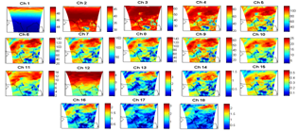
Sounder Standard Products (Level-1)
S.No. |  | Data Product | Processing Level | Format | Product Size
Standard Products
1 | Standard Product |  | L1B | HDF | 4.3

Slide 12
Sounder Geo-Physical Parameters (Level-2)
Geo-Physical Parameters (L2B) 26 MB (Single Product Contains all parameters)
1 | Vertical Profiles Mean Surface Pressure Mean Surface Elevation Temperature Profiles (Reg Retrieval) WV Profiles (Reg Retrieval) Ozone Profile (Reg Retrieval) Surface Skin Temperature (Reg. Retrieval) Temperature Profiles (Phy Retrieval) WV Profiles (Phy Retrieval) Surface Skin Temperature (Phy Retrieval) Total Ozone | Derived products Forecast Skin Temperature Forecast Surface Humidity Geo Potential Height (at 40 pressure levels) Total Precipitable Water Layer-1 (1000-900 hPa) Precipitable Water Layer-2 (900-700 hPa) Precipitable Water Layer-1 (700-300 hPa) Precipitable Water Lifted Index Wind Index Dry Microburst Index Maximum Vertical Theta-e

Slide 13
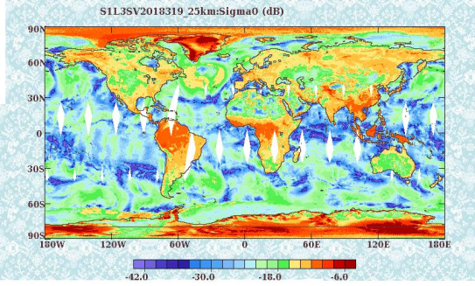
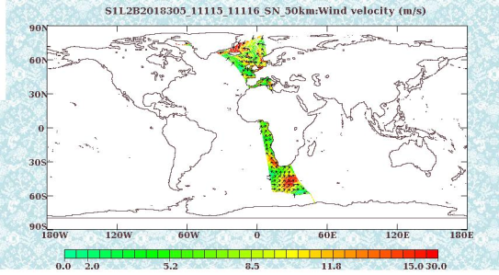
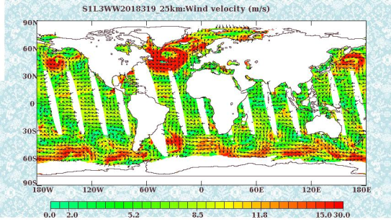
SCATSAT-1 : Operational Data Products
Product | L1B | L2A | L2B | L3S | L3W
Swath | 1800 km | 1800 km | 1800 km | Global | Global
Product definition | Half revolution | Half revolution | Half revolution | Full globe | Full globe
Cell size | -- | 50 km x 50 km, 25 km x 25 km | 50 km x 50km, 25 km x 25km | 0.5°X0.5°, 0.25°X0.25° | 0.5°X0.5°, 0.25°X0.25°
Parameter | Sigma0 | Sigma0 | Wind | Sigma0 | Wind
Format | HDF-5
Data source: (1) NRSC (www.nrsc.gov.in) (2) MOSDAC (www.mosdac.gov.in)

Slide 14
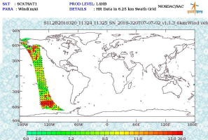
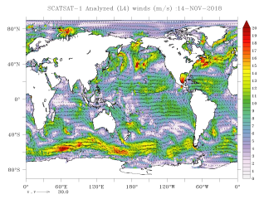
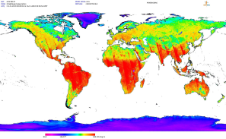
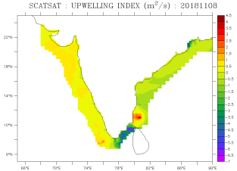
SCATSAT-1: Value Added Products
Product | L3BT | L3IC | L4AW | L4HW | L4FULLGLOBE | L4INDIA | L4 NPOLAR | L4 SPOLAR | L4UI
Definition | Brightness Temperature | Ice Mask | Analyzed winds | High spatial density winds | Global Sigma0/Gama0 | India Sigma0/Gama0 | Sigma0/Gama0 | Sigma0/Gama0 | Upwelling Index
Spatial Coverage | Global | Global | Global | Swath | Global | India | North Pole | South Pole | India
Generation frequency | Daily | Daily | Daily | Revolution-wise | Daily | Daily | Daily | Daily | Daily
Spatial Sampling | 0.25°X0.25° | 0.25°X0.25° | 0.25°X0.25° | 0.0625°X0.0625° | 0.02°X0.02° | 0.02°X0.02° | 0.02°X0.02° | 0.02°X0.02° | 0.25°X0.25°
Format | Geotiff | HDF5 | NetCDF | HDF5 | Geotiff | Geotiff | Geotiff | Geotiff | Netcdf
Data source: MOSDAC (https://mosdac.gov.in )

Slide 15
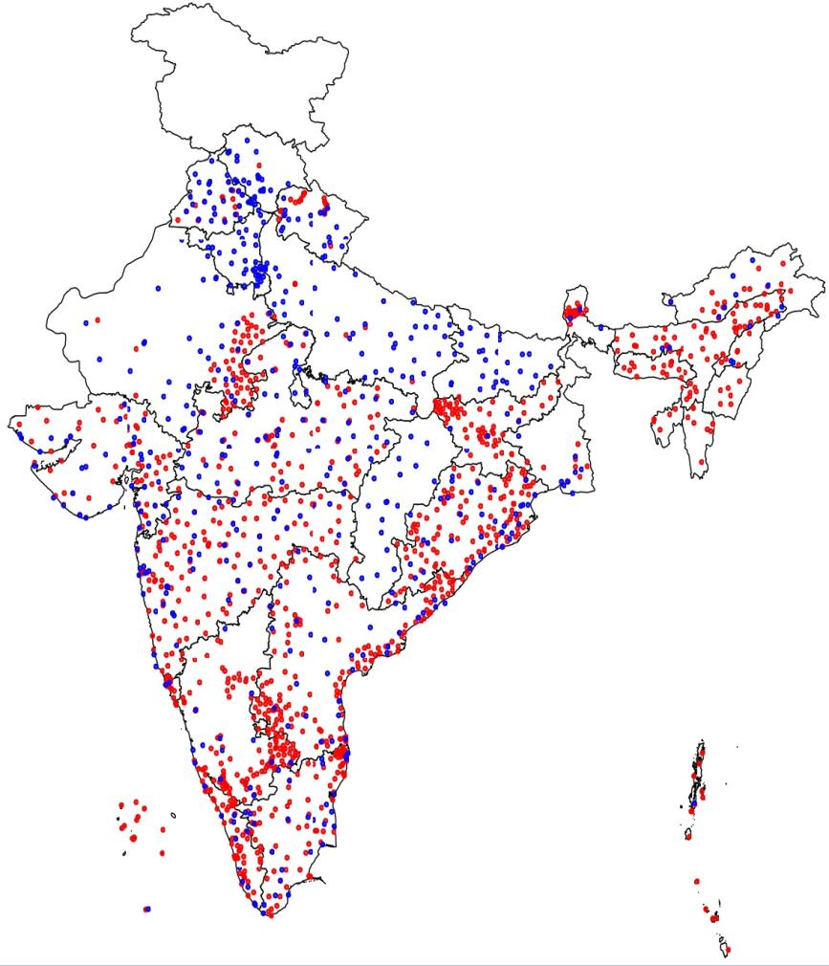
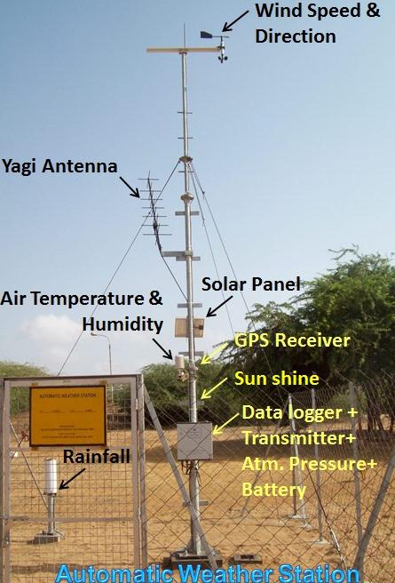
Automatic Weather Station (AWS)
• IMD AWS 500+
• ISRO AWS 1100+
Measures Met. parameters at ground level and transmit for every GMT automatically
Temperature
Pressure
Humidity
Wind speed & direction
Rainfall
Sun shine
AWS-TDMA installed across India

Slide 16
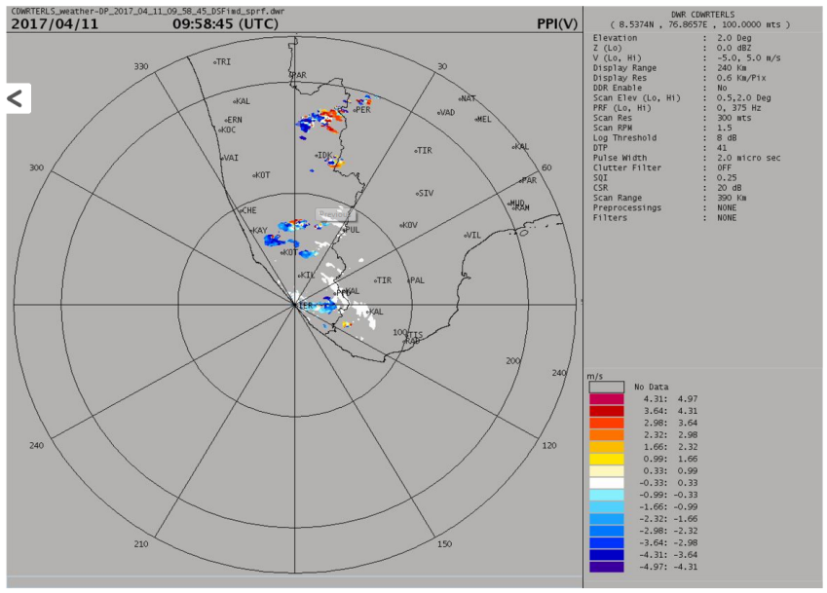
Doppler Weather Radar (DWR)
Presently Thumba Equatorial Rocket Launching Station (TERLS) and Cherrapunji DWR data is transferred to MOSDAC for archival and dissemination
Gopalpur DWR data will soon be available
TERLS DWR

Slide 17
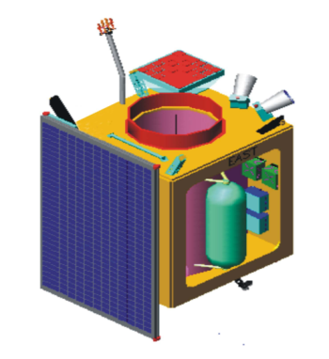
Planned Missions: GEO IMAGING SATELLITE (GISAT-1)
Geostationary orbit of 36,000 km
Every 30 minutes observation over India
High resolution multi-spectral VNIR (HRMX-VNIR): 50m Resolution
Hyper spectral VNIR: 320m Resolution
Hyper spectral SWIR (HyS-SWIR): 192m resolution
High resolution Multi-spectral (HRMX-TIR): 1.5km Resolution

Slide 18
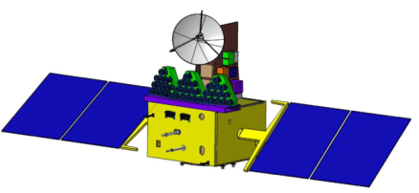
Planned Missions: OCEANSAT-3
OCEANSAT-3 is a global mission and is configured to cover global oceans and provide continuity of ocean colour data with global wind vector and characterization of lower atmosphere and ionosphere.
Objectives:
Continuity of ocean colour data with improvements to continue and enhance operational services like potential fishery zone and primary productivity.
To enhance the applications by way of simultaneous Sea Surface Temperature (SST) measurements, in addition to chlorophyll, using additional thermal channels, is envisaged in this mission.
Continuity of wind vector data through repeat of Scatterometer for cyclone forecasting and numerical weather modelling.
The mission, in tandem with Oceansat-2 (on availability), will improve the repetivity of ocean colour measurements to every 24 hour and wind vector measurements to every 12 hour.
Payloads:
An 13-band Ocean Colour Monitor (OCM) in VNIR (400-1010 nm range) with 360 m spatial resolution and 1400 km swath for ocean Colour monitoring
2-band Long Wave Infra Red (LWIR) around 11 and 12 μm for Sea Surface Temperature (thermal channels) at 1080 m resolution.
A Ku-Band Pencil beam SCATTEROMETER with a ground resolution of 50 km x 50 km for Continuity of wind vector data for cyclone forecasting and numerical weather modelling
Notes:
18

Slide 19
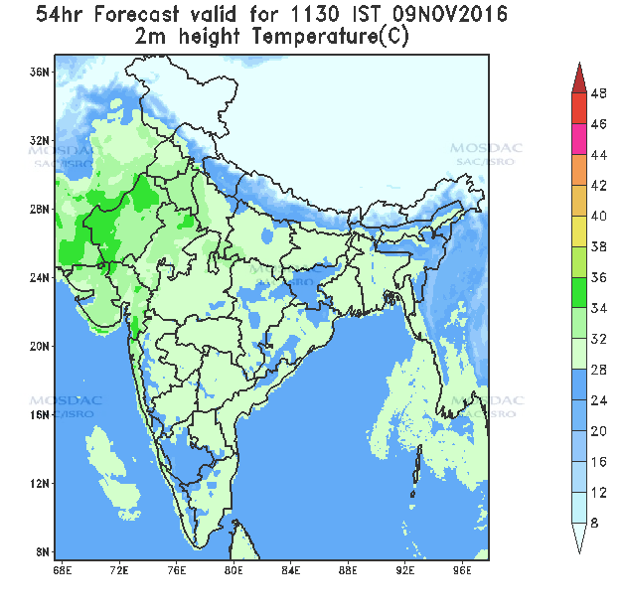
Weather Forecast: 5 Km
Weather Forecast
Weather Forecast every 24 hours
Temperature
Humidity
Cloud
Wind
Rain
Forecast for every 3 Hrs for 72 Hrs
Decision Support elements:
Location Based General Weather Forecast

Slide 20
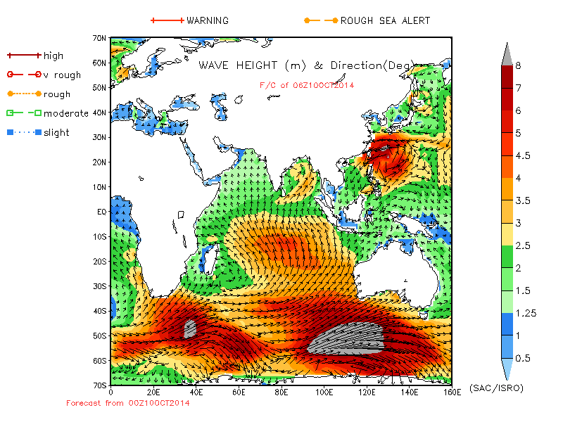
SEA STATE FORECAST
Forecasted Parameters:
Wave Height and Period
Swell Height
Wind Speed
Sea Level Anomaly
Sea Surface Currents
Sea Surface Salinity
Sea Surface Temperature
Forecast at every 6 hours for next 5 days
http://mosdac.gov.in

Slide 21
Thanks
nitant@sac.isro.gov.in
https://mosdac.gov.in

